Slide 1
Your First Job: How to Get the One You Want
And Keep the One You Get…

Slide 2
Preparation
Personal Mission: How to get from “Here” to “There”

Slide 3
Determining Your “There”
What’s your passion?
Filling your passion bucket.

Slide 4
Determining Your “There”
What do you want your Energy Chart to look like?
What are your components?
Pay attention to it.
Revise it regularly

Slide 5
Determining Your “There”
What do you want from your professional career?
Practice Emphasis
Clinical specialty?- May determine your setting
Setting specifics?- May determine your specialty
Leadership Aspirations
Clinical
Managerial/ Administrative
Advocacy

Slide 6
Determining Your “There”
Writing Your Personal Mission Statement

Slide 7
Preparation
Paperwork, Application and Interview

Slide 8
The Resume
Looks Professional
Formatted
Spelling and Grammar checked
Content
Experience that applies to the position
What have you accomplished that’s worth mentioning
References
Included
On request

Slide 9
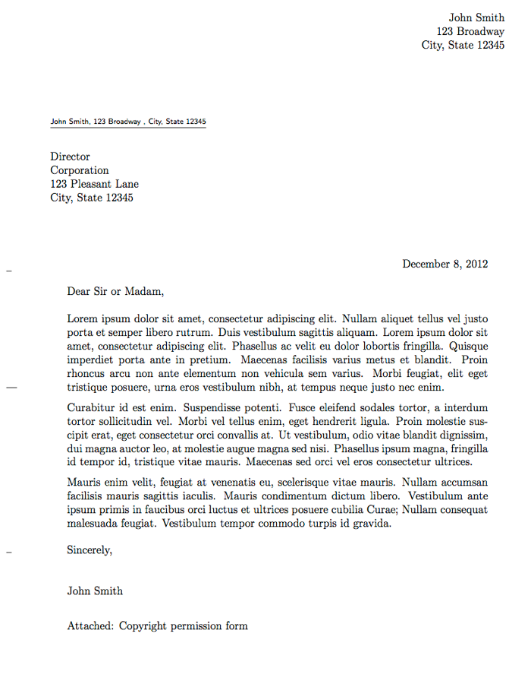
The Cover Letter
See the first 2 points on the resume…
Why you want THAT job
Synopsis of why you are the best candidate.

Slide 10
More…
The computer application- if required
Be Truthful
Be Complete
Remember, if you are applying through a Human Resource department, they are “scrubbing” the applicants for the hiring manager.
Follow-up
Write a “Thank You” letter.
Call? Maybe.

Slide 11
Presentation
The Interview

Slide 12
Preparation
Know the Company
Do some homework
What are they about? Reputation, specialty, etc.
Know Thyself
Profiling
Communication Style
DISC
Classic profile
Preparation
Be in the Moment
Mentally Sharp
Really listen
Be Curious- Ask smart questions

Slide 13
The Interview
You get 90 seconds for your first impression
Look good (professional)
Be comfortable
Be yourself
Smell good (or not at all)
Get a Clue! (or a cue)
Be prompt, but not overly anxious
How does the interviewer communicate?
Direct, Humor, Genuine- friendly, Detail
Be prepared for “soft” questions looking for behaviors
Be prepared for the same questions asked 3 ways

Slide 14
What Do Employers Want?
How to be successful in your first PT position…

Slide 15
What Employers Want
Become A Team Player
(The Ideal Team Player-Patrick Lencioni)
Humble
Share Credit
Emphasizes team over self
Defines success collectively rather than individually
Hungry
Self-motivated
Diligent
Sees Work- constantly looking for the next opportunity, and considering the next step
Smart
Common Sense
Good judgement in group situations
Intuition on the impacts of words and actions

Slide 16
What Employers Want
No liabilities
Bad Habits
Questionable Ethics
Unreliable
Attitudes- got an ax to grind
Strong convictions without good judgement
Stupid Behaviors
DWI
Harassment
Illegal
Immoral

